Slide 1
Color Image Science

Slide 2
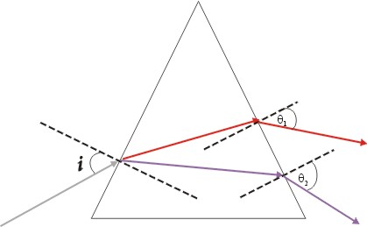
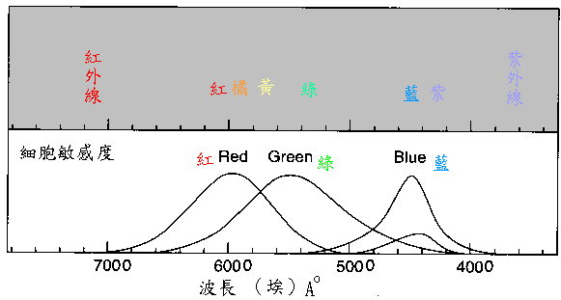
Color fundamentals
In 1665, Newton’s prism experiments dispel existing misconceptions, Red light is fastest. Due to its longest wavelength

Slide 3
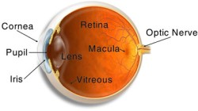
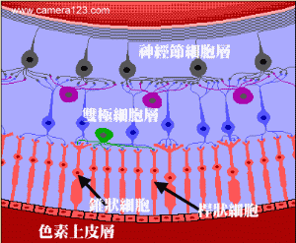
structure of the eyeball
角膜
視網膜
黃斑
瞳孔
水晶體
視神經
玻璃體
虹膜

Slide 4
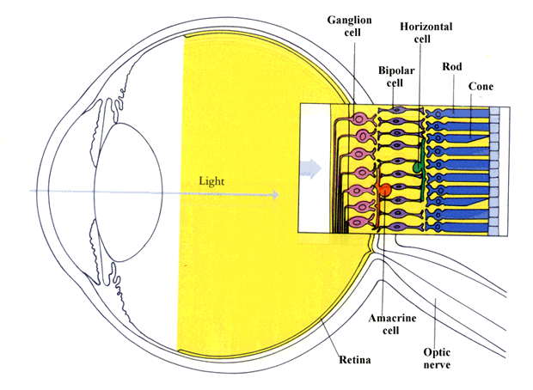
神經節細胞
水平細胞
兩極細胞
錐狀細胞具色彩辨識能力，但數量較少，故人的眼睛對明暗對比的判定較色彩變化來得敏感。
無軸突細胞
視神經

Slide 5
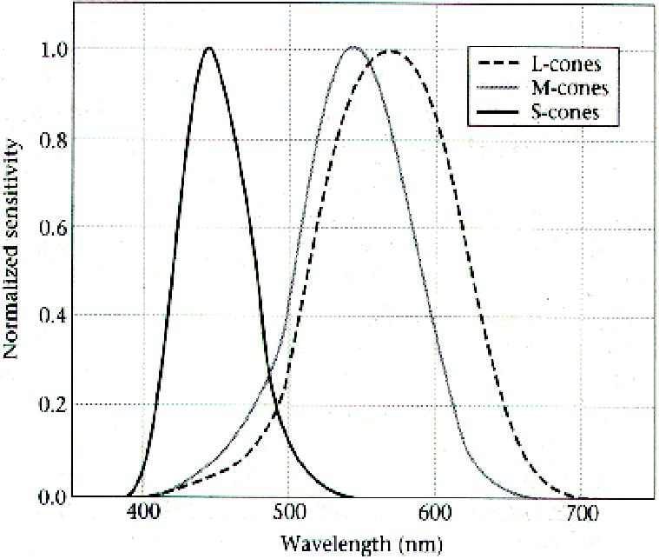
Human cone fundamentals
Red
Blue
Green

Slide 6
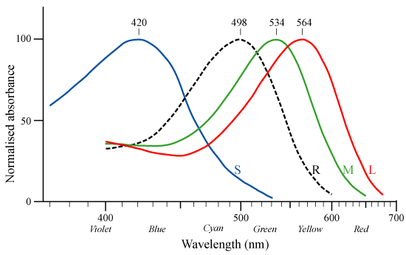
Cone response
Spectral absorption curves of the short (S) , medium (M) and long (L) wavelength pigments in human cone and rod (R) cells.

Slide 7
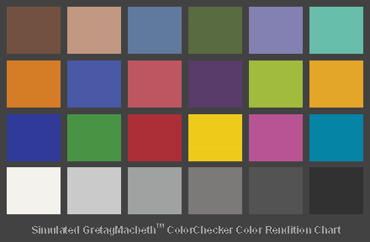
Macbeth Color Checker
Dark skin
Light skin
Blue sky
Foliage
Blue flower
Bluish green
orange
Purplish blue
Moderate red
purple
Yellow green
Orange yellow
blue
green
red
yellow
magenta
cyan
White
Neutral 8
Neutral 6.5
Neutral 5
Neutral 3.5
black

Slide 8
Red Green Blue of Macbeth color checker
R=94 G=28 B=13 | R=241 G=149 B=108 | R=97 G=119 B=171 | R=90 G=103 B=39 | R=164 G=131 B=196 | R=140 G=253 B=153
R=255 G=116 B=21 | R=7 G=47 B=122 | R=222 G=29 B=42 | R=69 G=0 B=68 | R=187 G=255 B=19 | R=255 G=142 B=0
R=0 G=0 B=142 | R=64 G=173 B=38 | R=203 G=0 B=0 | R=255 G=217 B=0 | R=207 G=3 B=124 | R=0 G=148 B=189
R=255 G=255 B=255 | R=249 G=249 B=249 | R=180 G=180 B=180 | R=117 G=117 B=117 | R=53 G=53 B=53 | R=0 G=0 B=0

Slide 9
Chromaticity coordinates( x, y ) and luminance values Y of Macbeth color checker
x=0.400 y=0.350 Y=10.1 | x=0.377 y=0.345 Y=35.8 | x=0.247 y=0.251 Y=19.3 | x=0.337 y=0.422 Y=13.3 | x=0.265 y=0.240 Y=24.3 | x=0.261 y=0.343 Y=43.1
x=0.506 y=0.407 Y=30.1 | x=0.211 y=0.175 Y=12.0 | x=0.453 y=0.306 Y=19.8 | x=0.285 y=0.202 Y=6.6 | x=0.380 y=0.489 Y=44.3 | x=0.473 y=0.438 Y=43.1
x=0.187 y=0.129 Y=6.1 | x=0.305 y=0.478 Y=23.4 | x=0.539 y=0.313 Y=12.0 | x=0.448 y=0.470 Y=59.1 | x=0.364 y=0.233 Y=19.8 | x=0.196 y=0.252 Y=19.8
x=0.310 y=0.316 Y=90.0 | x=0.310 y=0.316 Y=59.1 | x=0.310 y=0.316 Y=36.2 | x=0.310 y=0.316 Y=19.8 | x=0.310 y=0.316 Y=9.0 | x=0.310 y=0.316 Y=3.1

Slide 10
CIE L*a*b（1976）
L* = brightness
a* = red and green content
b* = yellow and blue content
CIE 1976 L*a*b* is based directly on CIE XYZ
and is an attempt to linearize the perceptibility of
color differences.

Slide 11
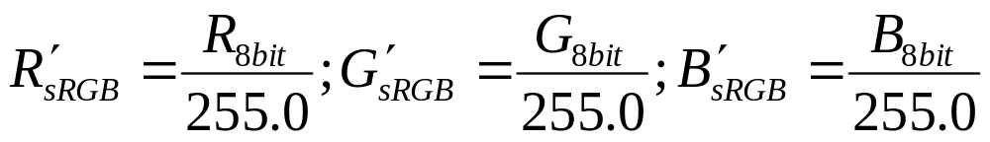

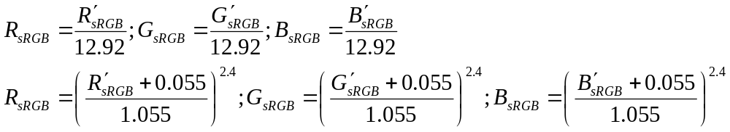
8 bit sRGB -> nonlinear sRGB -> linear sRGB
8 bit sRGB -> nonlinear sRGB
8 bit integer sRGB values are converted to floating point non-linear sR’G’B’ values
nonlinear sRGB -> linear sRGB
The nonlinear sR’G’B’ values are transformed to linear R_{sRGB} , G_{sRGB}, B_{sRGB} values
If R’_{sRGB}, G’_{sRGB}, B’_{sRGB}<=0.04045
If R’_{sRGB}, G’_{sRGB}, B’_{sRGB}>0.04045

Slide 12
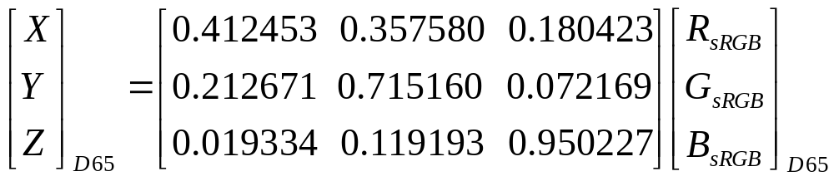
sRGB to XYZ transformation
X: red Y: green Z: blue
These three component X, Y and Z are pseudo color, not true color in physic.

Slide 13
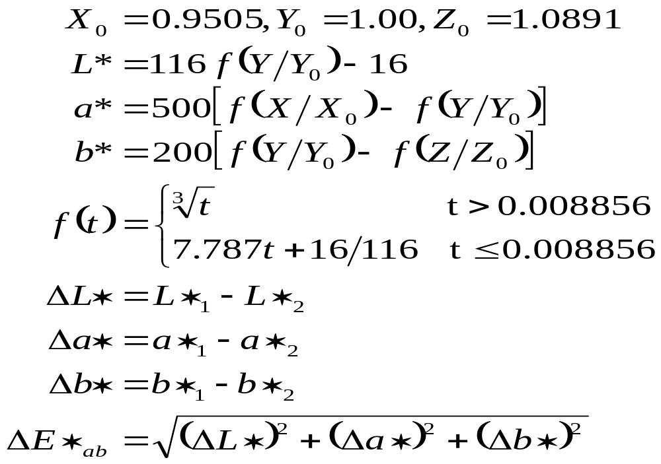
CIE 1976 L*a*b*(CIELAB)
With the D65 reference white: X0 = 0.9505, Y0 = 1.00, Z0 = 1.0891
With the D50 reference white: X0 = 0.9642, Y0 = 1.00, Z0 = 0.8249
明度差
色度差
色度差
總色差

Slide 14
example
在2°標準觀察者和C光源的照明條件下，測得用黃色油墨印製的三個樣品色度坐標
No 1: Y=71.79， x=0.4210， y=0.4788
No 2: Y=70.67， x=0.4321， y=0.4889
No 3: Y=67.95， x=0.4441， y=0.4947
C light : Y0=100， x0=0.3101， y0=0.3162
Answer:
No1: Y1=71.79, X1=63.13, Z1=15.02
No2: Y2=70.60, X2=62.46, Z2=11.43
No3: Y3=67.95, X3=61.00, Z3=8.40
C light：Y0=100, X0=98.07, Z0=118.22

Slide 15
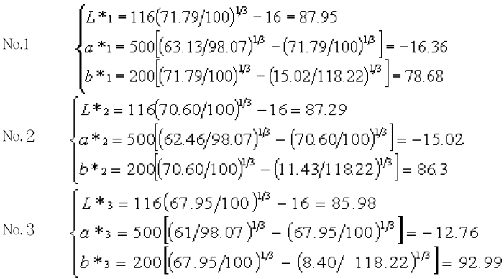
假定以樣品色No.1為標準，計算出它們的色差值：
△L* △a* △b* △E*ab
No.2-No.1 -0.6638 1.3287 7.6053 7.7490
No.3-No.1 -1.9727 3.5920 14.3055 14.8809

